Slide 1


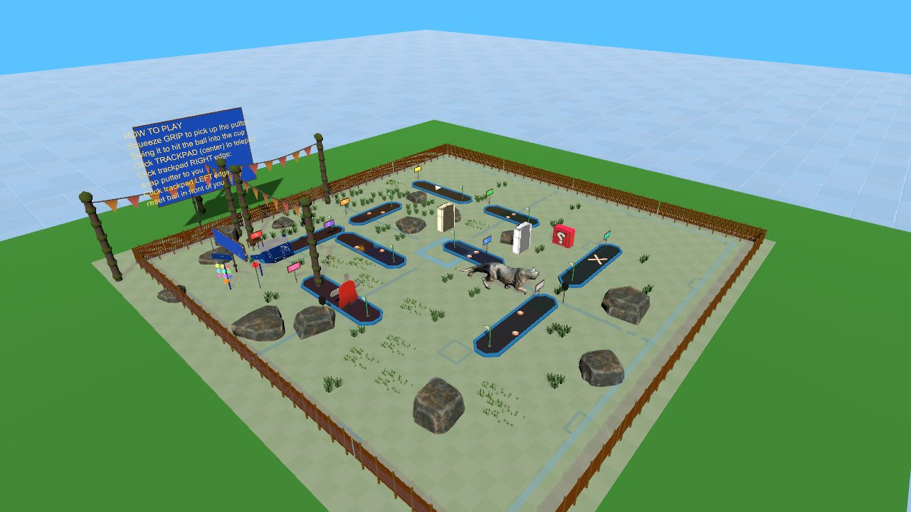

Virtual Reality
SteamVR setup, the Interaction System, and how GolfVR was built
Wednesdays at 6:00pm
CIST 1423 - 2010 VIRTUAL REALITY PROGRAMMING AND TECHNOLOGY
Lab tonight: build a teleport + grab test scene, then read GolfVR
Notes:
Syllabus Ch. 3 covers VR setup with the XR Interaction Toolkit. We use SteamVR instead because the lab Vive Pros and our Alumni Weekend GolfVR project run on it. Repo folders: Week-04-SteamVR-Setup and Week-05-SteamVR-Interactions.

Slide 2



Agenda
SteamVR setup
Interaction System
GolfVR case study
Project, OpenVR loader, SteamVR Input actions
Player, teleport, grab, buttons: the lab scene
How the Alumni Weekend course uses the same parts
Notes:
Three parts: set up the project (Week 4 README), tour and build with the Interaction System (Week 5 README), then read real code from GolfVR.

Slide 3

Today
By the end of class you can…
Explain rendering, tracking, input, and why the SteamVR plugin needs the OpenVR loader first
Tonight's plan
1
Week 4
Setup: loaders, SteamVR Input, run the sample
Set up a SteamVR project and generate SteamVR Input actions
2
Wk5 0–30
Tour Interactions_Example
30–50
How grabbing works + build the Playground
Map XRI concepts to Interaction System components and describe a grab in four steps
3
55–115
Station rotation: six stations
Drive your own scripts from events, actions, and LinearMapping (levers and wheels)
115–130
Code reading: GolfPutter
4
130–150
Share-out + exit ticket
CIST 1423 — Weeks 4–5 — SteamVR Setup & the Interaction System
Notes:
Two sessions. Lesson plans: Lesson-Plans/Week-04-SteamVR-Setup.md and Lesson-Plans/Week-05-SteamVR-Playground.md

Slide 4



What does VR development involve?
A VR app is still a Unity app. It adds three jobs, and SteamVR covers each one.
Rendering
Tracking
Input
Draw the scene twice per frame (one image per eye)
90 Hz with no dropped frames, or people feel sick
The OpenVR XR plug-in takes over the camera
Headset and both controllers: position and rotation every frame (6DOF)
SteamVR_Behaviour_Pose on each hand
The Player prefab wires it all up
Map buttons to actions like "Grab" or "Teleport"
actions.json plus one bindings file per controller
Code reads actions, never raw buttons
Everything else is interaction design: how do you pick something up, move, or press a button with no mouse?
CIST 1423 — Weeks 4–5 — SteamVR Setup & the Interaction System
Notes:
Keep this framing: most of the class is interaction design, not rendering.

Slide 5

Headset approaches: which SDK?
OpenVR and OpenXR are runtimes, the layer between Unity and the headset. Pick the SDK that fits the hardware.
Approach | Runs on | Unity package | Use it when
SteamVR / OpenVR (this course) | PC VR: Vive, Index, Quest via Link | SteamVR Plugin 2.8 + OpenVR XR Plugin | Lab headsets. Includes the ready-made Interaction System
OpenXR + XR Interaction Toolkit (textbook) | Nearly everything, incl. standalone Quest | com.unity.xr.openxr + XRI | Cross-vendor or Android builds
Meta XR SDK | Quest only | Meta XR All-in-One SDK | Passthrough, scene API, hand tracking
WebXR | Any headset browser | None (JavaScript + three.js) | No install. See the WebXR deck
Key idea
SteamVR can act as an OpenXR runtime too, but the SteamVR Plugin's Input and Interaction System only work when the OpenVR loader is active.
CIST 1423 — Weeks 4–5 — SteamVR Setup & the Interaction System
Notes:
The textbook row is XRI. Point out that GolfVR has both OpenVR and OpenXR loaders installed, with OpenVR first.

Slide 6

Lab 4: create the SteamVR project
Five steps. Week-04-SteamVR-Setup/README.md has every click.
1. New project
›
2. Import plugin
›
3. XR Plug-in Mgmt
›
4. SteamVR Input
›
5. Run the sample
3D (Built-In) template, Unity 2022.3 LTS. Not URP: Interaction System materials turn pink.
SteamVR Plugin 2.8 (Asset Store or GitHub release). Click "Accept All" on the settings pop-up.
PC tab: check OpenVR Loader and list it first. Single Pass Instanced, mirror Right eye.
Window → SteamVR Input → copy example JSONs → Save and generate.
Open Interactions_Example.unity (in the Samples folder), headset on, press Play.
No headset at home?
The Player prefab's "Allow Toggle To 2D" switches to a keyboard-and-mouse fallback when SteamVR can't start (WASD, mouse look, click to grab). It plays the role of XRI's XR Device Simulator.
CIST 1423 — Weeks 4–5 — SteamVR Setup & the Interaction System
Notes:
Step 3 is highlighted because it causes the most first-day problems. GolfVR's Assets/XR/XRGeneralSettingsPerBuildTarget.asset lists OpenVRLoader then OpenXRLoader.

Slide 7

SteamVR Input: the default action set
Save and generate writes StreamingAssets/SteamVR/actions.json and generates the SteamVR_Actions C# class.
Action | Type | Vive Wand | Used by
GrabPinch | Boolean | Trigger | Picking things up
GrabGrip | Boolean | Grip | Picking things up
Teleport | Boolean | Trackpad center | Teleporting prefab
InteractUI | Boolean | Trigger | UI buttons
SnapTurnLeft / Right | Boolean | Trackpad edges | Snap turn (GolfVR repurposes)
Menu | Boolean | Menu button | Free for your game
Haptic | Vibration | — | hand.TriggerHapticPulse
Actions, not raw buttons
You name what the game needs once, in actions.json
A bindings file per controller maps buttons to actions (bindings_vive_controller.json, bindings_oculus_touch.json, …)
Swap Vive Wands for Index or Quest and the code never changes
Window → SteamVR Input → Open binding UI to remap
CIST 1423 — Weeks 4–5 — SteamVR Setup & the Interaction System
Notes:
These are the exact action names in GolfVR's actions.json. The Menu action is what our Week 5 MenuButtonSpawner reads.

Slide 8





Common first-day problems
Almost every "it doesn't work" in Week 4 is one of these five.
Game view works, headset is black
→ OpenVR Loader unchecked, or OpenXR listed above it
Hands show up, buttons do nothing
→ Skipped "Save and generate" in the SteamVR Input window
Everything is pink
→ The project is URP. Start again from the Built-In template
Errors about missing actions.json
→ Delete StreamingAssets/SteamVR and re-copy the example JSONs
Quest shows Meta home, not SteamVR
→ Connect Link first, then launch SteamVR from the desktop
CIST 1423 — Weeks 4–5 — SteamVR Setup & the Interaction System
Notes:
Have students check these before asking for help. The deliverable template has a "Problems I hit" section for them to record fixes.

Slide 9
Touring Interactions_Example: XRI → SteamVR
Every concept in the textbook's XRI demo scene has a SteamVR Interaction System counterpart.
Textbook (XRI) | SteamVR Interaction System | Where in the sample
XR Origin / player rig | Player prefab: VRCamera, LeftHand, RightHand, 2D fallback | Core/Prefabs/Player.prefab
Teleportation Provider | Teleporting prefab: arc and player move | Teleport/Prefabs/Teleporting.prefab
Teleportation Area / Anchor | TeleportArea on any mesh / TeleportPoint prefab | Floor / pads around the room
XR Grab Interactable | Interactable + Throwable | Table of throwables
UI button / poke button | UIElement on a uGUI Button / HoverButton | Floating panel / push buttons
Lever, dial | LinearDrive / CircularDrive | Slider and wheel stations
Gaze, climbing | Not built in (use a VRCamera raycast); Longbow and Buggy Buddy show 2-hand and vehicle attach | Samples/, Longbow/
XR Device Simulator | Player → Allow Toggle To 2D | Automatic with no headset
CIST 1423 — Weeks 4–5 — SteamVR Setup & the Interaction System
Notes:
Walk the sample scene live and stop at each station. All of these components are used in Interactions_Example (checked by GUID).

Slide 10

How grabbing actually works
Four steps, all inside Hand.cs and Throwable.cs. You rarely write any of it.
1
Hover
2
Grab
3
Hold
4
Release
Each Hand has a small hover sphere that highlights the closest Interactable
GrabPinch (trigger) or GrabGrip goes down → hand.AttachObject(obj, grabType, flags)
attachmentFlags decide the feel: parent to hand, snap to palm, go kinematic
Throwable copies the hand's velocity estimate onto the Rigidbody, so throws keep your arm's speed
// Throwable's default flags
attachmentFlags = Hand.AttachmentFlags.ParentToHand
| Hand.AttachmentFlags.DetachFromOtherHand
| Hand.AttachmentFlags.TurnOnKinematic;
// GolfVR's putter adds SnapOnAttach so the grip
// lands exactly in your palm
Try it
Remove TurnOnKinematic from a Throwable. What happens to a held cube that touches the table?
Add SnapOnAttach. How does the grip change?
CIST 1423 — Weeks 4–5 — SteamVR Setup & the Interaction System
Notes:
Flags come from Throwable.cs in SteamVR 2.8. GolfVR has a BugFixVerificationTest that checks the putter's flags include SnapOnAttach.

Slide 11
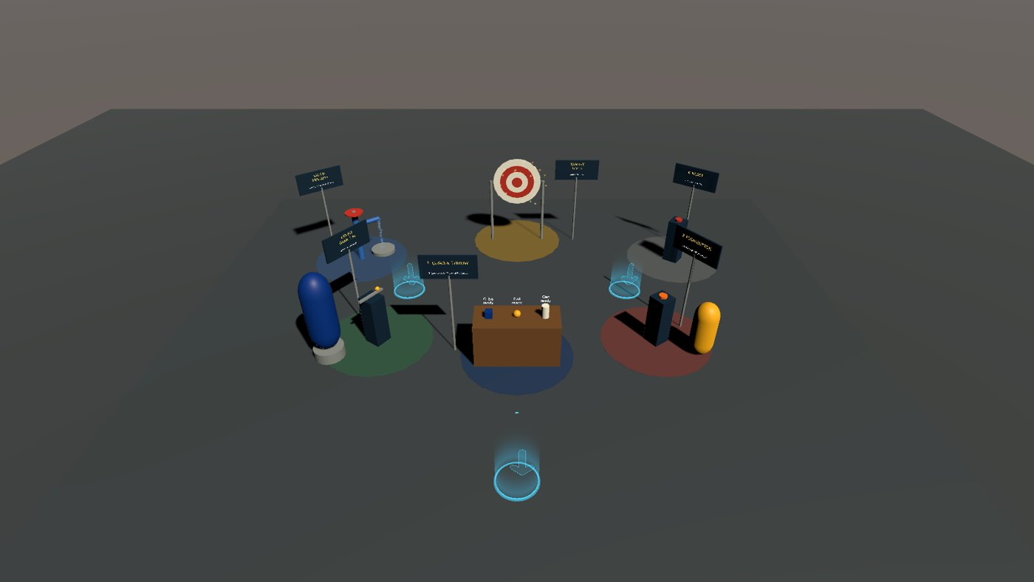


Lab 5: the SteamVR Playground
Copy Week-05-SteamVR-Interactions/Assets into your Week 4 project → SteamVR Playground → Build Test Scene.
Built by a menu command
Stock prefabs: Player, Teleporting, TeleportPoint
Re-running deletes and rebuilds: always safe
Same pattern as Week 2
Station rotation
Pairs, 12 minutes per station, in order
Predict → try → explain → change it
Driver in the headset, navigator at the keyboard
Six numbered stations around the start point. Every station has a sign; three signs are live readouts.
CIST 1423 — Weeks 4–5 — SteamVR Setup & the Interaction System
Notes:
Builder: Assets/Editor/BuildSteamVRPlayground.cs. Needs the SteamVR plugin and a Built-In pipeline project. Lesson plan: Lesson-Plans/Week-05-SteamVR-Playground.md (station guide with predict/explain/change prompts and answers).

Slide 12






Six stations, six Interaction System ideas
Each station is one component plus one small script you can read in five minutes.
1 Grab & throw
2 Target
3 Push button
Throwable + GrabReporter
Events, haptics, release velocity
ThrowTarget: score, sparks, chime
OnCollisionEnter + relative velocity
HoverButton + PittColorButton
onButtonDown is a UnityEvent<Hand>
4 Lever
5 Valve wheel
6 Reset kiosk
LinearDrive → LinearMapping (0–1)
LeverScaler: Ch. 5 slider-scale, physically
CircularDrive, two turns
ValveFlow drives a water ParticleSystem
ResetStation + ResettablePose
Never resets what is in a hand (GolfVR kiosk)
Plus: a teleport area and three teleport pads; the Menu button spawns cubes (reads a SteamVR action directly).
CIST 1423 — Weeks 4–5 — SteamVR Setup & the Interaction System
Notes:
Predict questions (answers): 1 Can vs ball speed? Same: Throwable copies hand velocity. 2 Cube resting on the board: hit? No, below 1.2 m/s. 4 Knob in the middle: scale? 1.0x. 5 Turns from shut to full? Two (maxAngle 720).

Slide 13
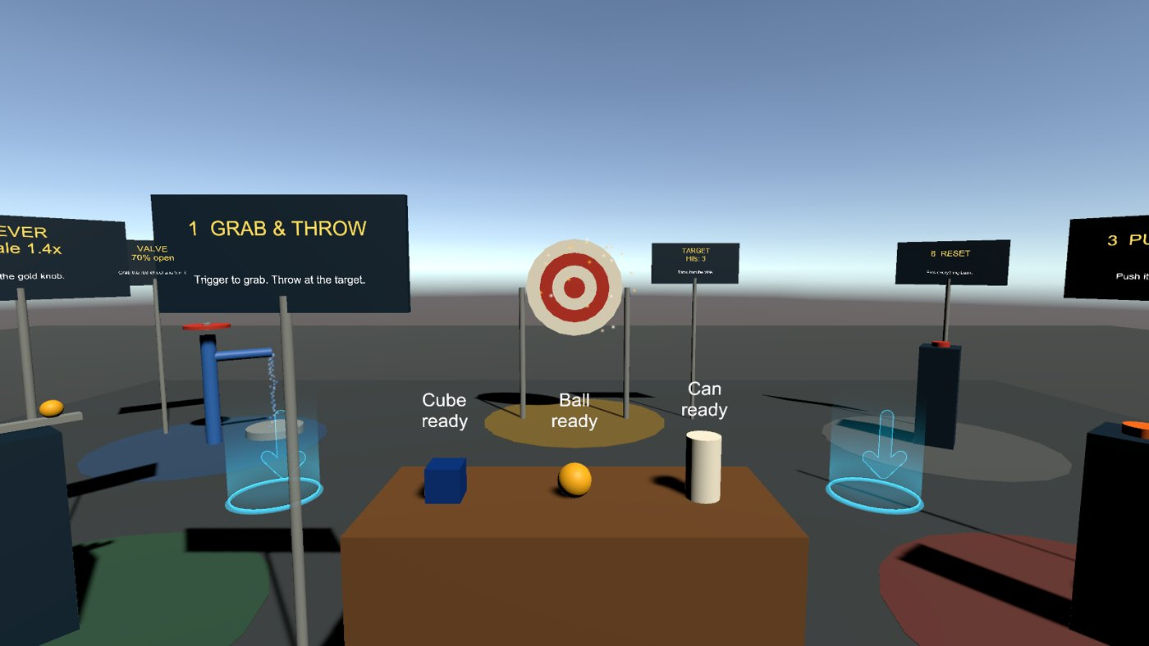
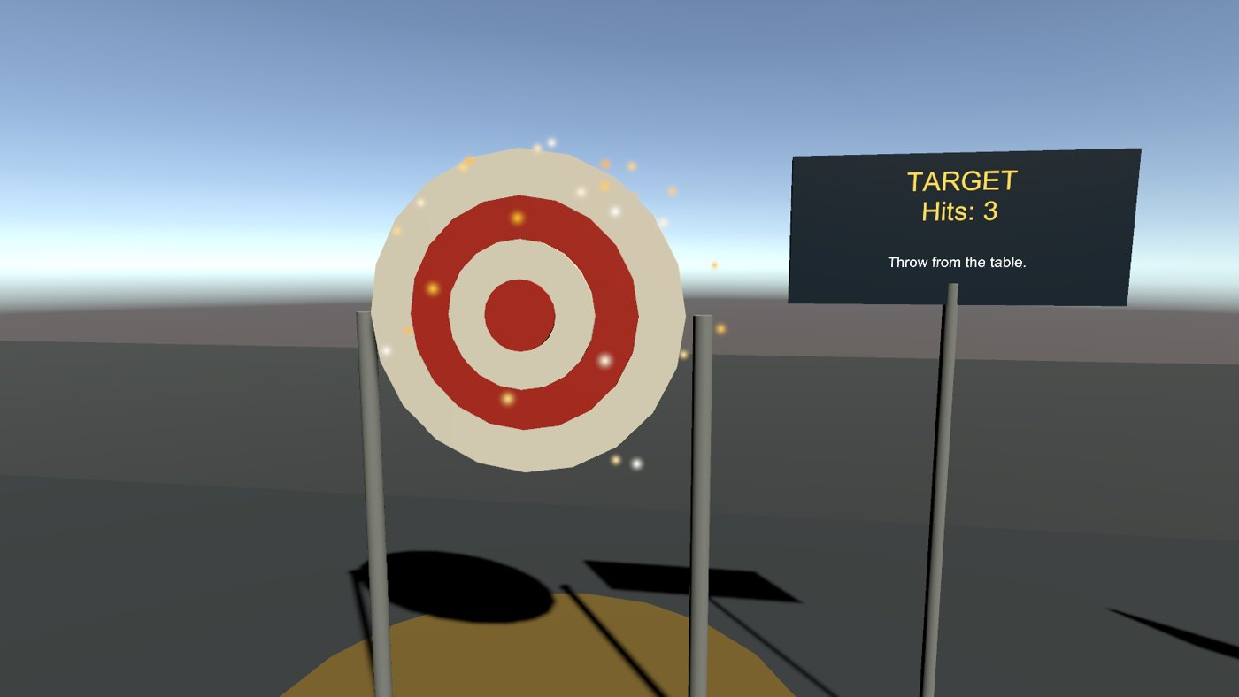
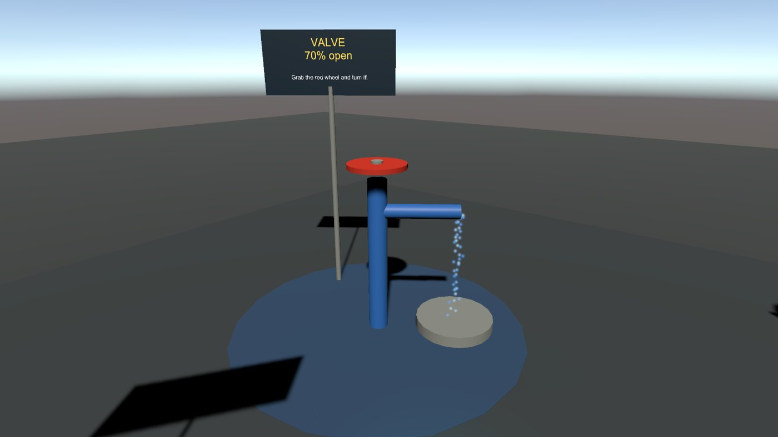
What you will see
Rendered in Unity 2022.3 with SteamVR 2.8. The same run compiled every script and checked each station’s logic.
From the start point: table in front, target behind it
Target after three hits: score, sparks, chime
Valve 70% open: the stream follows the wheel
Earlier renders caught two real bugs before anyone put on a headset: mirrored labels and magenta (material-less) particles.
CIST 1423 — Weeks 4–5 — SteamVR Setup & the Interaction System
Notes:
Screenshots: Week-05-SteamVR-Interactions/docs (six views, including the lever and buttons).

Slide 14


Levers and wheels: one number, 0 to 1
LinearDrive and CircularDrive only write LinearMapping.value. Your script decides what it means.
// LeverScaler.cs: lever position -> statue size
float s = Mathf.Lerp(minScale, maxScale, mapping.value);
target.localScale = baseScale * s;
// ValveFlow.cs: wheel angle -> water flow
var emission = water.emission;
emission.rateOverTime = mapping.value * maxRate;
// CircularDrive setup (done by the builder)
drive.axisOfRotation = CircularDrive.Axis_t.YAxis;
drive.limited = true;
drive.minAngle = 0; drive.maxAngle = 720; // two turns
Change it
Lever drives colour instead of size (Color.Lerp)
Valve "sticks" below 10%
Same idea, on the web
panther-builder: a scale slider
WaterWorks: a gate valve, synced to everyone
CIST 1423 — Weeks 4–5 — SteamVR Setup & the Interaction System
Notes:
The textbook Ch. 5 exercise scales an object with a UI slider; the lever is the physical version. Week 9 builds the UI version.

Slide 15

Two ways to read input
Let the Interaction System do the work when you can. Read an action yourself when a button has game meaning.
// 1) React to Interaction System events (GrabReporter.cs)
interactable.onAttachedToHand += OnGrabbed;
void OnGrabbed(Hand hand) {
hand.TriggerHapticPulse(1500);
Debug.Log($"grabbed by {hand.handType}");
}
// 2) Read a SteamVR action yourself (MenuButtonSpawner.cs)
public SteamVR_Action_Boolean spawnAction =
SteamVR_Input.GetAction<SteamVR_Action_Boolean>("default", "Menu");
if (spawnAction.GetStateDown(SteamVR_Input_Sources.Any)) Spawn(pos);
When to use which
Events: grab, release, hover, button press. The hand already knows
Actions: "reset", "open menu", "spawn": buttons with game meaning
Field initializer + GetAction is the pattern Valve's own samples use (BuggyController, JoeJeffController)
SteamVR_Input_Sources.LeftHand / RightHand / Any: pass hand.handType so one script works on either hand
CIST 1423 — Weeks 4–5 — SteamVR Setup & the Interaction System
Notes:
Both scripts are in Week-05-SteamVR-Interactions/Assets/Scripts.

Slide 16
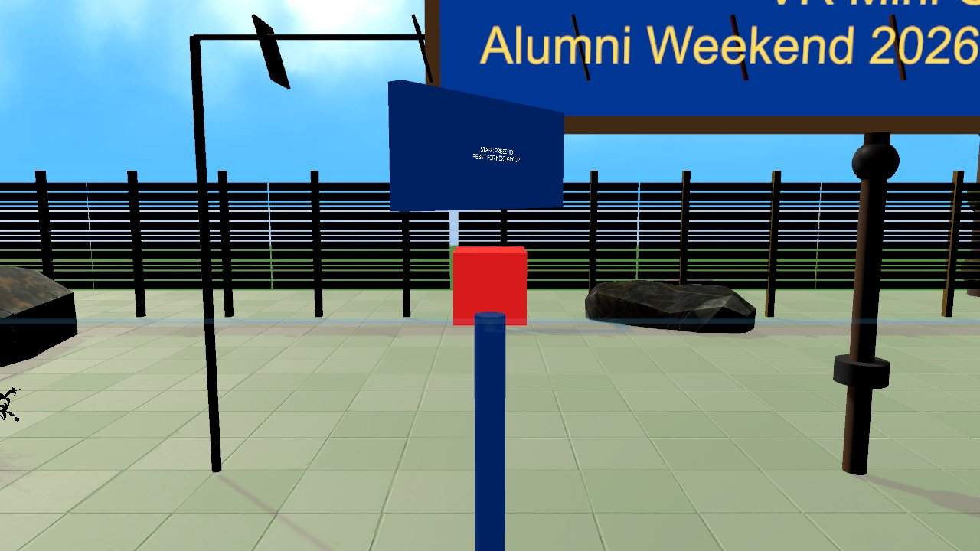



Case study: GolfVR (Alumni Weekend 2026)
A 9-hole mini-golf course on the Vive Pro, built from the same Interaction System parts.
GolfPutter.cs
Interactable + Throwable with a gripPoint. Club-head velocity → impulse on the ball → haptic buzz
QuickResetController.cs
Rebinds SnapTurnLeft/Right to "reset ball" and "fetch putter"
ResetRoundButton.cs + friends
HoverButtons: staff reset, NEXT HOLE, jump to a hole
Reset-for-next-group kiosk: a HoverButton
MiniGolfGameManager / ScoreboardUI
Ordinary Unity logic. Very little of the project is VR-specific
Alumni-Weekend-2026/GolfVR/GolfVR: open it next to your Lab 5 project and compare
CIST 1423 — Weeks 4–5 — SteamVR Setup & the Interaction System
Notes:
Reading order is in the Week 5 README section 4. GolfVR Docs/README.md also covers its Edit-mode test tools.

Slide 17


Reading GolfPutter.cs: swing → putt
Velocity from position deltas in FixedUpdate. The strike happens in OnCollisionEnter.
void FixedUpdate() {
// Estimate swing velocity of the club head
Vector3 p = clubHead.position;
_headVelocity = (p - _lastHeadPosition) / Time.fixedDeltaTime;
_lastHeadPosition = p;
}
void OnCollisionEnter(Collision c) {
GolfBall ball = c.gameObject.GetComponent<GolfBall>();
float speed = _headVelocity.magnitude;
if (ball == null || speed < minSwingSpeed) return;
Vector3 dir = _headVelocity.normalized;
dir.y = Mathf.Clamp(dir.y, 0f, 0.25f); // keep putts on the green
float power = Mathf.Min(speed * powerMultiplier, maxBallSpeed);
ball.ReceivePutt(dir.normalized * power);
_currentHoldingHand?.TriggerHapticPulse(0.12f, 160f, 0.75f);
}
Where does _currentHoldingHand come from?
interactable.onAttachedToHand += OnAttached
The same event GrabReporter uses in Lab 5
Discuss
Why estimate velocity by hand instead of reading the Rigidbody?
What would powerMultiplier = 5 feel like?
CIST 1423 — Weeks 4–5 — SteamVR Setup & the Interaction System
Notes:
Code is simplified from GolfPutter.cs (the null-conditional on the hand stands in for the original if/try block). Hint for the discussion: a held putter is kinematic, so its Rigidbody velocity is not useful.

Slide 18



Deliverables & resources
Week 4: setup write-up
Week 5: teleport + grab test
Markdown write-up of your setup steps, using the README template
Loaders (in order), action set, one rebind idea
Screenshot of Interactions_Example running; push project + README.md
Checklist: teleport area, teleport point, grab, throw, button
Paste GrabReporter Console lines; screenshots or a short clip
One change you made and what surprised you
Links
This repo: github.com/jcallinan/CIST1423-Fall2026-Examples → Week-04-SteamVR-Setup, Week-05-SteamVR-Interactions
SteamVR Unity Plugin releases: github.com/ValveSoftware/steamvr_unity_plugin/releases
Plugin docs: valvesoftware.github.io/steamvr_unity_plugin
GolfVR: Alumni-Weekend-2026/GolfVR/GolfVR (Docs/README.md for controls and tests)
CIST 1423 — Weeks 4–5 — SteamVR Setup & the Interaction System
Notes:
Both deliverable templates are at the bottom of the week READMEs.

Slide 19
Check your understanding
Answer with a partner first, then we'll compare.
Q1
Q2
OpenXR is listed above OpenVR in XR Plug-in Management. What breaks?
Hands appear but no button does anything. Most likely cause?
Q3
Q4
A held cube passes through the table. Which attachment flag is responsible?
The lever knob is at the middle. What scale is the statue?
CIST 1423 — Weeks 4–5 — SteamVR Setup & the Interaction System
Notes:
Answers:
Q1. OpenXR is listed above OpenVR in XR Plug-in Management. What breaks?
The SteamVR plugin’s Input and Interaction System, which need the OpenVR loader active.
Q2. Hands appear but no button does anything. Most likely cause?
SteamVR Input was never saved and generated.
Q3. A held cube passes through the table. Which attachment flag is responsible?
TurnOnKinematic: a kinematic body is not pushed by collisions.
Q4. The lever knob is at the middle. What scale is the statue?
1.0x: Lerp(0.4, 1.6, 0.5).

Slide 20

Next steps: homework + planning
Finish Lab 4: SteamVR project running with Interactions_Example
Build the SteamVR Playground and record your teleport + grab test
Read GolfPutter.cs and QuickResetController.cs before next class
Next up: Week 6, AR Foundation. Then Week 7: WebXR building
CIST 1423 — Weeks 4–5 — SteamVR Setup & the Interaction System
Notes:
Transition to the WebXR deck.

